Slide 1
TWO PASS ASSEMBLER

Slide 2
Introduction
We take a sample input file and identify duplicate labels, invalid labels and also errors for wrong instructions and invalid operands and produce log file, listing file and object file(in binary)
Also implemented SET instruction

Slide 3
First Pass

Slide 4
Scan each line remove comments
Identify Labels
And save it with current PC
Search for mnemonics and operand in that line if found increment PC if it is valid and repeat.

Slide 5
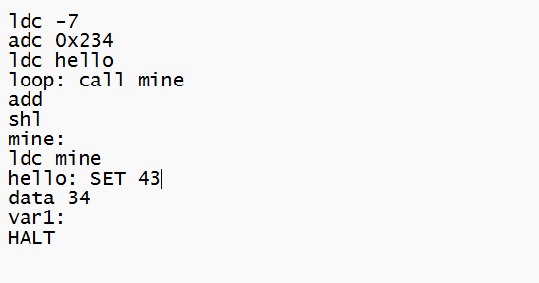
Line Num | PC | Label | Mnemonic | Operand
1 | 0 |  | ldc | -7
Consider a test file

Slide 6
Line Num | PC | Label | Mnemonic | Operand
1 | 0 |  | ldc | -7
2 | 1 |  | adc | 0x234

Slide 7
Line Num | PC | Label | Mnemonic | Operand
1 | 0 |  | ldc | -7
2 | 1 |  | adc | 0x234
3 | 2 |  | ldc | hello

Slide 8
Line Num | PC | Label | Mnemonic | Operand
1 | 0 |  | ldc | -7
2 | 1 |  | adc | 0x234
3 | 2 |  | ldc | hello
4 | 3 | loop: | call | mine

Slide 9
Line Num | PC | Label | Mnemonic | Operand
1 | 0 |  | ldc | -7
2 | 1 |  | adc | 0x234
3 | 2 |  | ldc | hello
4 | 3 | loop: | call | mine
5 | 4 |  | add

Slide 10
Line Num | PC | Label | Mnemonic | Operand
1 | 0 |  | ldc | -7
2 | 1 |  | adc | 0x234
3 | 2 |  | ldc | hello
4 | 3 | loop: | call | mine
5 | 4 |  | add
6 | 5 |  | shl

Slide 11
Line Num | PC | Label | Mnemonic | Operand
1 | 0 |  | ldc | -7
2 | 1 |  | adc | 0x234
3 | 2 |  | ldc | hello
4 | 3 | loop: | call | mine
5 | 4 |  | add
6 | 5 |  | shl
7 | 6 | mine:

Slide 12
Line Num | PC | Label | Mnemonic | Operand
1 | 0 |  | ldc | -7
2 | 1 |  | adc | 0x234
3 | 2 |  | ldc | hello
4 | 3 | loop: | call | mine
5 | 4 |  | add
6 | 5 |  | shl
7 | 6 | mine:
8 | 6 |  | ldc | mine
Note PC not incremented

Slide 13
Line Num | PC | Label | Mnemonic | Operand
1 | 0 |  | ldc | -7
2 | 1 |  | adc | 0x234
3 | 2 |  | ldc | hello
4 | 3 | loop: | call | mine
5 | 4 |  | add
6 | 5 |  | shl
7 | 6 | mine:
8 | 6 |  | ldc | mine
9 | 7(43) | hello: | SET | 43
Note that 43 is saved not as PC but as another variable corresponding to label hello

Slide 14
Line Num | PC | Label | Mnemonic | Operand
1 | 0 |  | ldc | -7
2 | 1 |  | adc | 0x234
3 | 2 |  | ldc | hello
4 | 3 | loop: | call | mine
5 | 4 |  | add
6 | 5 |  | shl
7 | 6 | mine:
8 | 6 |  | ldc | mine
9 | 7(43) | hello: | SET | 43
10 | 8 |  | data | 34

Slide 15
Line Num | PC | Label | Mnemonic | Operand
1 | 0 |  | ldc | -7
2 | 1 |  | adc | 0x234
3 | 2 |  | ldc | hello
4 | 3 | loop: | call | mine
5 | 4 |  | add
6 | 5 |  | shl
7 | 5 | mine:
8 | 6 |  | ldc | mine
9 | 7(43) | hello: | SET | 43
10 | 8 |  | data | 34
11 | 9 | var1:

Slide 16
Line Num | PC | Label | Mnemonic | Operand
1 | 0 |  | ldc | -7
2 | 1 |  | adc | 0x234
3 | 2 |  | ldc | hello
4 | 3 | loop: | call | mine
5 | 4 |  | add
6 | 5 |  | shl
7 | 6 | mine:
8 | 6 |  | ldc | mine
9 | 7(43) | hello: | SET | 43
10 | 8 |  | data | 34
11 | 9 | var1:
12 | 9 |  | HALT
Note PC not incremented

Slide 17
By now all the errors have been identified
And diagnosed.
Now we call the Second Pass to produce
Machine code for each instruction.

Slide 18
SECOND PASS

Slide 19
The machine code consists of operand and opcode.
The machine code is 32 bit divided as follows.
The opcode can be obtained from mnemonic.
It provides last 8 bits of machine code
The operand is available from first Pass.
It provides first 24 bits of machine code.

Slide 20
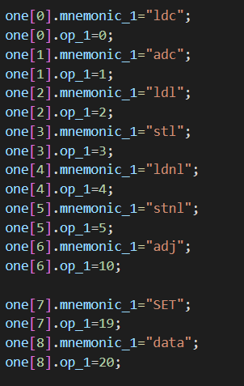
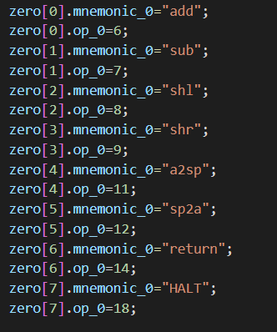
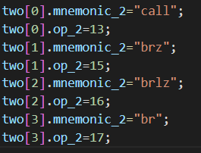
I have totally divided the all operands into 3 sets depending on type of operand
Instruction
Instruction with one operand
Instruction with
PC offset
Instruction with no operands
We consider SET and DATA as special case of instruction with one operand

Slide 21
PC | machine code |  | instr
 | operand | opcode
0 | "FFFFF9" | "00" | ldc -7
Line Num | PC | Label | Mnemonic | Operand
1 | 0 |  | ldc | -7
2 | 1 |  | adc | 0x234
3 | 2 |  | ldc | hello
4 | 3 | loop: | call | mine
5 | 4 |  | add
6 | 5 |  | shl
7 | 6 | mine:
8 | 6 |  | ldc | mine
9 | 7(43) | hello: | SET | 43
10 | 8 |  | data | 34
11 | 9 | var1:
12 | 9 |  | HALT
Opcode of the mnemonic “ldc”
Hexadecimal Representation of -7.
Since we need to provide the machine code in hexadecimal.

Slide 22
Note after every instruction PC incremented and corresponding instruction loaded
PC | machine code |  | instr
 | operand | opcode
0 | "FFFFF9" | "00" | ldc -7
1 | "000234" | "01" | adc 0x234
Line Num | PC | Label | Mnemonic | Operand
1 | 0 |  | ldc | -7
2 | 1 |  | adc | 0x234
3 | 2 |  | ldc | hello
4 | 3 | loop: | call | mine
5 | 4 |  | add
6 | 5 |  | shl
7 | 6 | mine:
8 | 6 |  | ldc | mine
9 | 7(43) | hello: | SET | 43
10 | 8 |  | data | 34
11 | 9 | var1:
12 | 9 |  | HALT
Opcode of the mnemonic “adc”
Since operand is already in hexadecimal. We just sign extend it to 24 bits.

Slide 23
PC | machine code |  | instr
 | operand | opcode
0 | "FFFFF9" | "00" | ldc -7
1 | "000234" | "01" | adc 0x234
2 | "00002B" | "00" | ldc hello
Line Num | PC | Label | Mnemonic | Operand
1 | 0 |  | ldc | -7
2 | 1 |  | adc | 0x234
3 | 2 |  | ldc | hello
4 | 3 | loop: | call | mine
5 | 4 |  | add
6 | 5 |  | shl
7 | 6 | mine:
8 | 6 |  | ldc | mine
9 | 7(43) | hello: | SET | 43
10 | 8 |  | data | 34
11 | 9 | var1:
12 | 9 |  | HALT
Opcode of the mnemonic “ldc”
Now here the task is to load the label.
Here we may have two cases the label might have already been “SET” to a quantity or else its been made default to PC. In this example hello is already been SET which we know from first PASS so therefore we need to load the set value of hello i.e 43 in hexadecimal.

Slide 24
PC | machine code |  | instr
 | operand | opcode
0 | "FFFFF9" | "00" | ldc -7
1 | "000234" | "01" | adc 0x234
2 | "00002B" | "00" | ldc hello
3 | "000002" | "0D" | loop: call mine
Line Num | PC | Label | Mnemonic | Operand
1 | 0 |  | ldc | -7
2 | 1 |  | adc | 0x234
3 | 2 |  | ldc | hello
4 | 3 | loop: | call | mine
5 | 4 |  | add
6 | 5 |  | shl
7 | 6 | mine:
8 | 6 |  | ldc | mine
9 | 7 | hello: | SET | 43
10 | 8 |  | data | 34
11 | 9 | var1:
12 | 9 |  | HALT
Opcode of the mnemonic “call”
“call” mnemonic is a third type in our classification. These instructions are like jump type. Now our simple task is that operand is the how many instructions should we jump from next instruction i.e
(Final PC) – (Present PC +1)
So from above equation our destination is “mine:” label at PC =6
Therefore jump=6-(3+1)=2 = operand.
That’s what we printed in operand column.

Slide 25
PC | machine code |  | instr
 | operand | opcode
0 | "FFFFF9" | "00" | ldc -7
1 | "000234" | "01" | adc 0x234
2 | "00002B" | "00" | ldc hello
3 | "000002" | "0D" | loop: call mine
4 | "000000" | "06" | add
Line Num | PC | Label | Mnemonic | Operand
1 | 0 |  | ldc | -7
2 | 1 |  | adc | 0x234
3 | 2 |  | ldc | hello
4 | 3 | loop: | call | mine
5 | 4 |  | add
6 | 5 |  | shl
7 | 6 | mine:
8 | 6 |  | ldc | mine
9 | 7(43) | hello: | SET | 43
10 | 8 |  | data | 34
11 | 9 | var1:
12 | 9 |  | HALT
Opcode of the mnemonic “add”
“add” instruction is instruction with zero operand. So by default we take operand as zero.

Slide 26
PC | machine code |  | instr
 | operand | opcode
0 | "FFFFF9" | "00" | ldc -7
1 | "000234" | "01" | adc 0x234
2 | "00002B" | "00" | ldc hello
3 | "000002" | "0D" | loop: call mine
4 | "000000" | "06" | add
5 | "000000" | "08" | shl
Line Num | PC | Label | Mnemonic | Operand
1 | 0 |  | ldc | -7
2 | 1 |  | adc | 0x234
3 | 2 |  | ldc | hello
4 | 3 | loop: | call | mine
5 | 4 |  | add
6 | 5 |  | shl
7 | 6 | mine:
8 | 6 |  | ldc | mine
9 | 7(43) | hello: | SET | 43
10 | 8 |  | data | 34
11 | 9 | var1:
12 | 9 |  | HALT
Opcode of the mnemonic “shl”
“shl” instruction is instruction with zero operand. So by default we take operand as zero.

Slide 27
PC | machine code |  | instr
 | operand | opcode
0 | "FFFFF9" | "00" | ldc -7
1 | "000234" | "01" | adc 0x234
2 | "00002B" | "00" | ldc hello
3 | "000002" | "0D" | loop: call mine
4 | "000000" | "06" | add
5 | "000000" | "08" | shl
6 |  |  | mine:
Line Num | PC | Label | Mnemonic | Operand
1 | 0 |  | ldc | -7
2 | 1 |  | adc | 0x234
3 | 2 |  | ldc | hello
4 | 3 | loop: | call | mine
5 | 4 |  | add
6 | 5 |  | shl
7 | 6 | mine:
8 | 6 |  | ldc | mine
9 | 7(43) | hello: | SET | 43
10 | 8 |  | data | 34
11 | 9 | var1:
12 | 9 |  | HALT
Now there is no instruction. So PC is not incremented until we get a instruction.

Slide 28
PC | machine code |  | instr
 | operand | opcode
0 | "FFFFF9" | "00" | ldc -7
1 | "000234" | "01" | adc 0x234
2 | "00002B" | "00" | ldc hello
3 | "000002" | "0D" | loop: call mine
4 | "000000" | "06" | add
5 | "000000" | "08" | shl
6 |  |  | mine:
6 | "000006" | "00" | ldc mine
Line Num | PC | Label | Mnemonic | Operand
1 | 0 |  | ldc | -7
2 | 1 |  | adc | 0x234
3 | 2 |  | ldc | hello
4 | 3 | loop: | call | mine
5 | 4 |  | add
6 | 5 |  | shl
7 | 6 | mine:
8 | 6 |  | ldc | mine
9 | 7(43) | hello: | SET | 43
10 | 8 |  | data | 34
11 | 9 | var1:
12 | 9 |  | HALT
Here we have to load a label which is not set. Therefore operand equal equals to default value i.e PC of label “mine” i.e 6

Slide 29
PC | machine code |  | instr
 | operand | opcode
0 | "FFFFF9" | "00" | ldc -7
1 | "000234" | "01" | adc 0x234
2 | "00002B" | "00" | ldc hello
3 | "000002" | "0D" | loop: call mine
4 | "000000" | "06" | add
5 | "000000" | "08" | shl
6 |  |  | mine:
6 | "000006" | "00" | mine: ldc mine
7 | "0000002B" |  | hello: SET 43
Line Num | PC | Label | Mnemonic | Operand
1 | 0 |  | ldc | -7
2 | 1 |  | adc | 0x234
3 | 2 |  | ldc | hello
4 | 3 | loop: | call | mine
5 | 4 |  | add
6 | 5 |  | shl
7 | 6 | mine:
8 | 6 |  | ldc | mine
9 | 7(43) | hello: | SET | 43
10 | 8 |  | data | 34
11 | 9 | var1:
12 | 9 |  | HALT
The SET instruction is already done in first pass here machine code is just the set value i.e 43 in hexadecimal.

Slide 30
PC | machine code |  | instr
 | operand | opcode
0 | "FFFFF9" | "00" | ldc -7
1 | "000234" | "01" | adc 0x234
2 | "00002B" | "00" | ldc hello
3 | "000002" | "0D" | loop: call mine
4 | "000000" | "06" | add
5 | "000000" | "08" | shl
6 |  |  | mine:
6 | "000006" | "00" | mine: ldc mine
7 | "0000002B" |  | hello: SET 43
8 | "00000022" |  | data 34
Line Num | PC | Label | Mnemonic | Operand
1 | 0 |  | ldc | -7
2 | 1 |  | adc | 0x234
3 | 2 |  | ldc | hello
4 | 3 | loop: | call | mine
5 | 4 |  | add
6 | 5 |  | shl
7 | 6 | mine:
8 | 6 |  | ldc | mine
9 | 7(43) | hello: | SET | 43
10 | 8 |  | data | 34
11 | 9 | var1:
12 | 9 |  | HALT
Another Special instruction data. The machine code here is produced from hexadecimal value of operand given i.e 34. This instruction just reserves a space for given data in memory.

Slide 31
PC | machine code |  | instr
 | operand | opcode
0 | "FFFFF9" | "00" | ldc -7
1 | "000234" | "01" | adc 0x234
2 | "00002B" | "00" | ldc hello
3 | "000002" | "0D" | loop: call mine
4 | "000000" | "06" | add
5 | "000000" | "08" | shl
6 |  |  | mine:
6 | "000006" | "00" | mine: ldc mine
7 | "0000002B" |  | hello: SET 43
8 | "00000022" |  | data 34
9 |  |  | var1:
Line Num | PC | Label | Mnemonic | Operand
1 | 0 |  | ldc | -7
2 | 1 |  | adc | 0x234
3 | 2 |  | ldc | hello
4 | 3 | loop: | call | mine
5 | 4 |  | add
6 | 5 |  | shl
7 | 6 | mine:
8 | 6 |  | ldc | mine
9 | 7(43) | hello: | SET | 43
10 | 8 |  | data | 34
11 | 9 | var1:
12 | 9 |  | HALT
Now there is no instruction. So PC is not incremented until we get a instruction.

Slide 32
PC | machine code |  | instr
 | operand | opcode
0 | "FFFFF9" | "00" | ldc -7
1 | "000234" | "01" | adc 0x234
2 | "00002B" | "00" | ldc hello
3 | "000002" | "0D" | loop: call mine
4 | "000000" | "06" | add
5 | "000000" | "08" | shl
6 |  |  | mine:
6 | "000006" | "00" | mine: ldc mine
7 | "0000002B" |  | hello: SET 43
8 | "00000022" |  | data 34
9 |  |  | var1:
9 | "000000" | "12" | HALT
Line Num | PC | Label | Mnemonic | Operand
1 | 0 |  | ldc | -7
2 | 1 |  | adc | 0x234
3 | 2 |  | ldc | hello
4 | 3 | loop: | call | mine
5 | 4 |  | add
6 | 5 |  | shl
7 | 6 | mine:
8 | 6 |  | ldc | mine
9 | 7(43) | hello: | SET | 43
10 | 8 |  | data | 34
11 | 9 | var1:
12 | 9 |  | HALT
Opcode for “HALT”
The halt instruction is instruction with no operand. So operand is default 0.

Slide 33
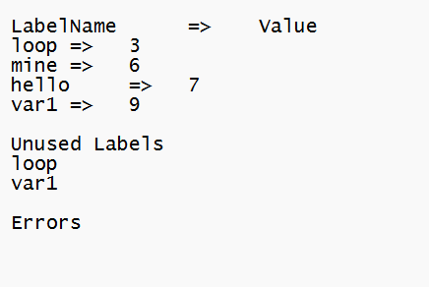
LOG FILE

Slide 34
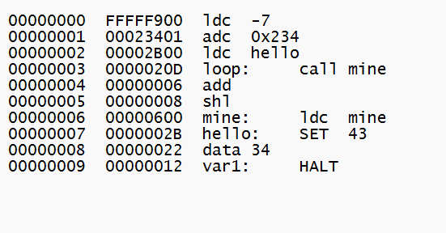
LIST FILE

Slide 35
SINGAM SETTY S A DESHIK
2101AI32
singam_2101ai32@iitp.ac.in

